Slide 1

RECITATION 2
EG1004

Slide 2
AGENDA
Engineering Beyond the Classroom
Technical Writing
Citing Sources
Microsoft Project
Introduction to Semester Long Design Projects
2

Slide 3
ENGINEERING BEYOND THE CLASSROOM

Slide 4


ENGINEERING BEYOND THE CLASSROOM
Professional Societies
Majors & disciplines
Honors programs and career building
Blogs & News Sources
MIT Technology Review, TechCrunch, Wired
Professional Engineering License
Fundamentals of Engineering Exam
PE Exam/Graduate School/Continuing Education
4

Slide 5
ENGINEERING BEYOND THE CLASSROOM
ASME (Mechanical)
ASCE (Civil)
IEEE (Electrical)
AIChE (Chemical)
AIAA (Aerospace)
ASEE (Engineering Education)
NSPE (Professional Engineering)
Tau Beta Pi (Honors)
SWE (Society of Women Engineers)
SHPE (Society of Hispanic Professional Engineers)
NSBE (National Society of Black Engineers)
SASE (Society of Asian Scientists & Engineers)
5

Slide 6

HOW TO GET INVOLVED?
NYU Tandon Student Affairs Website
NYU Tandon Student Organizations
NYU Engage pages for each club
NYU Tandon Club Fest
Club Fest & Resource Fair Info
Club & Organization Directory
Talk to EG TAs!
Many TAs are club leaders (or know them)
Ask how to get connected!
6

Slide 7
TECHNICAL WRITING
Notes:
The following slides go through a sample published research paper. While in EG 1003 you are not writing a research paper, you will notice a lot of similarities between a research paper and the lab reports you’ll write for the course. It’s also important to understand the structure of these published papers as you will likely read many throughout your educational and professional career.

Slide 8
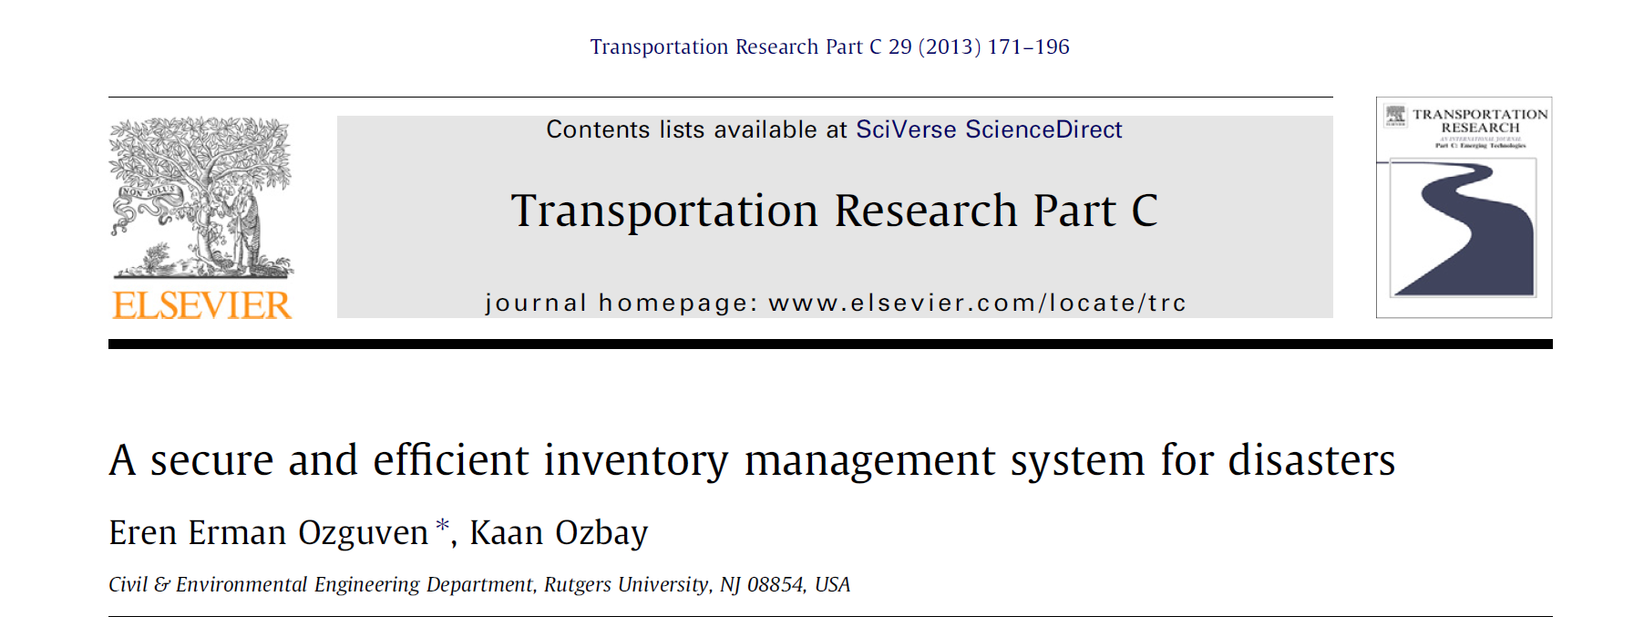
TECHNICAL WRITING
PUBLIC IDENTIFICATION
8
Notes:
This publication is one available through NYU Libraries’ online subscription to Elsevier (which has a large amount of publications in all fields). At the top middle next to the Elsevier symbol, is the journal in which this paper was originally published. Below you see the publication title which gives a brief insight to the research contained within. Under the title, the authors names are listed as well as the University that the authors are affiliated with, in this case, Rutgers.

Slide 9
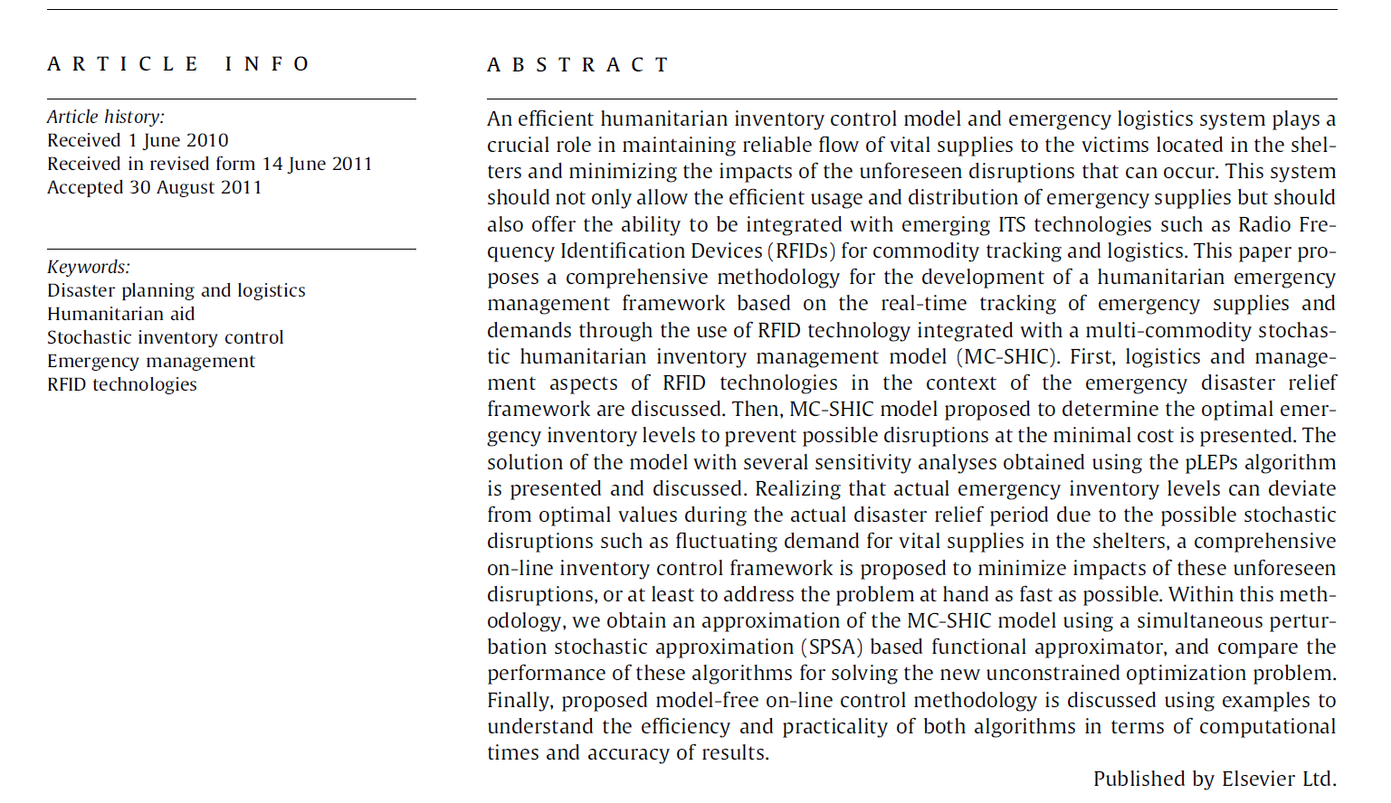
TECHNICAL WRITING
ABSTRACT
z
9
Notes:
This is an example of the abstract section of a publication. The abstract contains an overview of the objectives of the experiment and outcomes. Unlike this example abstract, you should aim for your abstract to be five to six sentences which is roughly equivalent to the highlighted portion above.

Slide 10
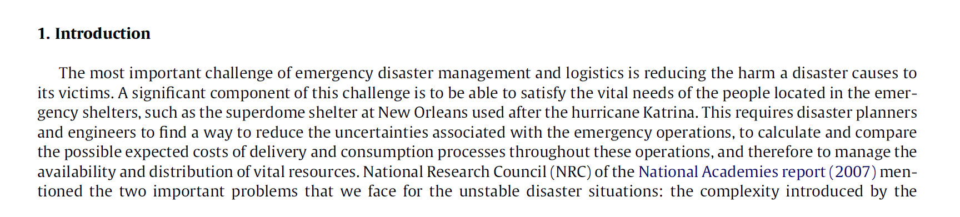
TECHNICAL WRITING
INTRODUCTION
10
Notes:
The introduction of your lab report should include the relevance of the lab and why the technology or engineering principles are relevant to us today as consumers and engineers. In your lab report introduction you also need to include the scientific principles present in the lab and relevant equations -- this is not shown in the research paper above.

Slide 11
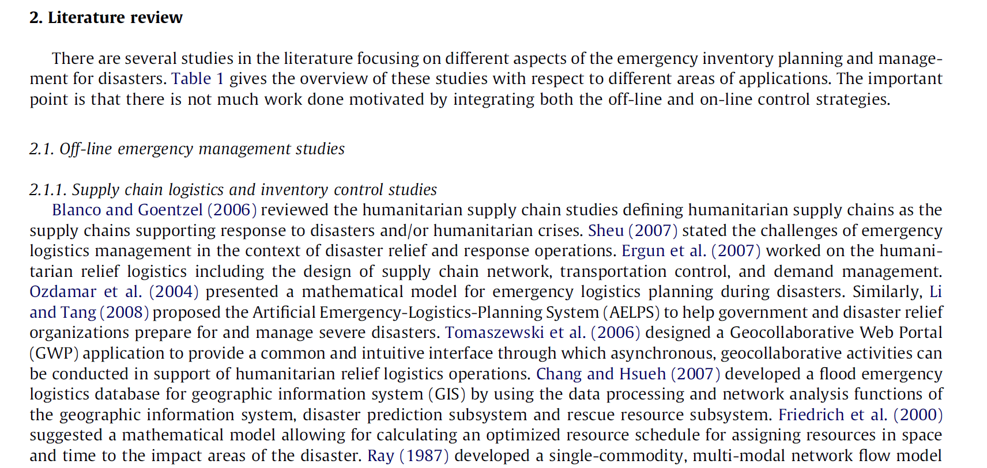
TECHNICAL WRITING
PROCEDURE
11
Notes:
The procedure of your lab report should outline the steps you took during the lab. The procedure in this example is a literature review which is more like the information you’ll include in your introduction section.

Slide 12

TECHNICAL WRITING
IN-TEXT CITATION
12
Notes:
Throughout your lab report you will reference other sources and it is important to give proper credit. The highlights above show two different styles of in text citations.

Slide 13
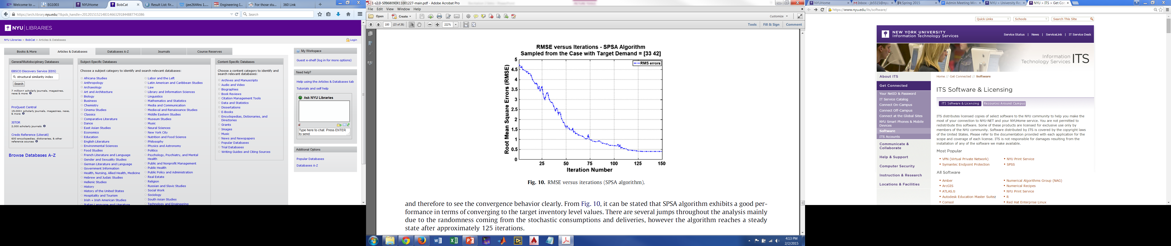
TECHNICAL WRITING
FIGURES
13
Notes:
In your lab report, images and charts will be shown as figures that are assigned numbers chronologically. Figures are labeled below the image and are referenced by name within the body of the text.

Slide 14
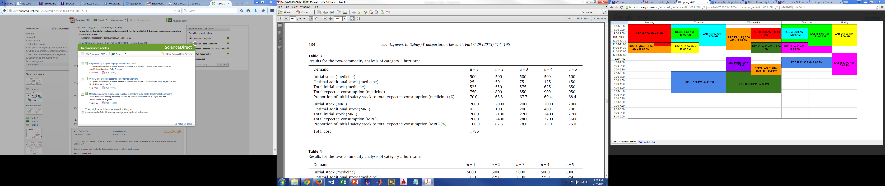
TECHNICAL WRITING
TABLES
14
Notes:
Tables help to present data collected in experiments. Tables are labeled above the data and are also referenced in the body of the text.

Slide 15

TECHNICAL WRITING
DATA & OBSERVATIONS
15
Notes:
The data and observations section includes the majority of the figures and tables in your report. In addition, sample calculations should be shown in the data and observation section.

Slide 16
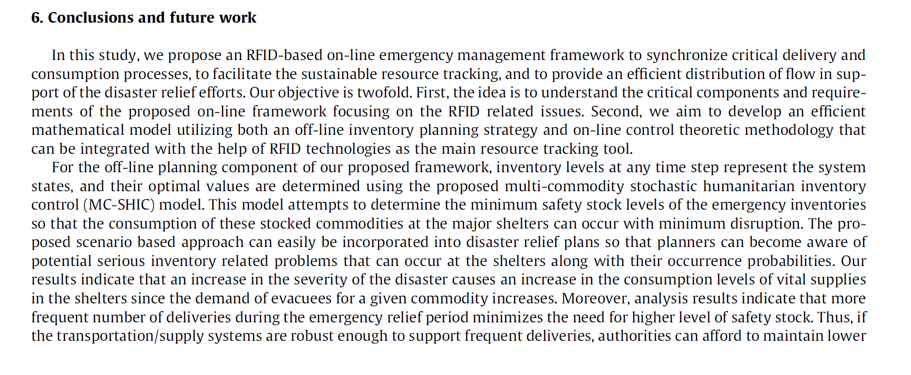
TECHNICAL WRITING
DISCUSSIONS & CONCLUSIONS
16
Notes:
The discussion and conclusion section should explain your findings and the outcome of the experiment. Future improvements and additional work that could be completed should also be mentioned.

Slide 17

TECHNICAL WRITING
CONTRIBUTION STATEMENT
Active voice, short paragraph
Individual reports:
How did you contribute during the lab exercise?
Why was your contribution important/significant?
Team reports:
How did each member contribute to the lab exercise?
Why were their contributions important/significant?
How did each member contribute to writing the report?
17
Notes:
The paragraph needs to be added to the end of every conclusion. This does NOT apply to lab 3 lab reports. This applies to Lab 4 lab report and all the other lab reports after that. Ask them to refer to the Sample Lab Report page available on the manual under Writing Resources if they are confused. The paragraph is a part of the conclusion so it does not need a separate title.

Slide 18
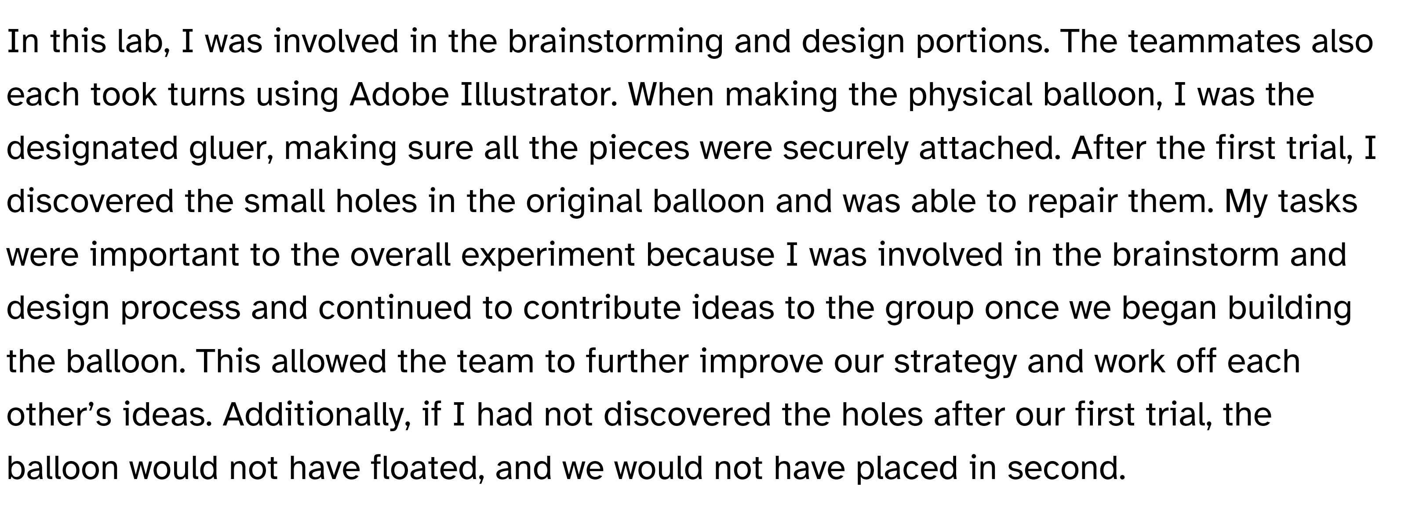
TECHNICAL WRITING
CONTRIBUTION STATEMENT EXAMPLE
18
Notes:
This example is also in the sample lab report manual page.

Slide 19
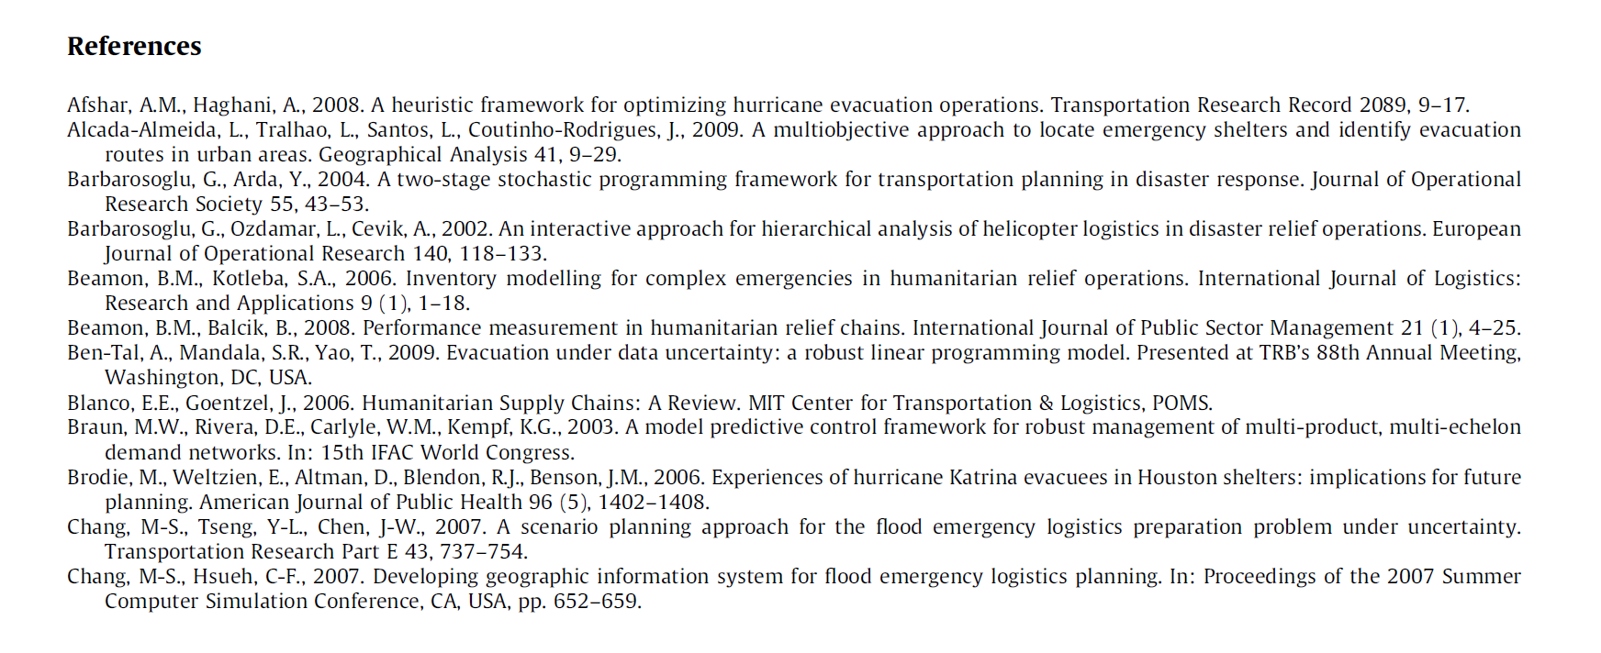
TECHNICAL WRITING
WORKS CITED
19
Notes:
Not only do you need to cite your sources in text, but all sources used in the report must be listed in the ‘works cited’ section. Some sources such as Google Scholar have citations for sources listed in different writing styles. You should also cite writing resources utilized such as a dictionary.

Slide 20
TECHNICAL WRITING
FINDING SOURCES
Google & Wikipedia
Google Scholar
NYU Libraries’ BobCat
Textbooks
Electronic or physical copies
FE Reference Manual
20
Notes:
When writing lab reports you should ensure that you are referencing academic sources. Google and Wikipedia are okay to address at first to refine your search criteria, but ultimately your sources need to be academic. Google scholar is a resource open to the general public to find academic articles, however, not all results will be academic and many will link to external resources that require subscriptions. NYU Libraries’ BobCat search tool allows full access to multiple research libraries.

Slide 21
QUESTIONS?

